Slide 1
SORTING
TEAM CRYSTALS
MEMBERS
Anuja Ajay
Aysha Fathima
Nimisha R S
Sankari Suresh

Slide 2
SORTING:
Sorting is the process of arranging the elements of an array so that they can be placed either in ascending or descending order.

Slide 3
1.SELECTION SORT
2.INSERTION SORT
3.BUBBLE SORT
4.MERGE SORT
5.QUICK SORT
TYPES OF SORTING

Slide 4
SELECTION SORT
1.

Slide 5
SELECTION SORT
Selection sort is a simple and efficient sorting algorithm that works by repeatedly selecting the smallest (or largest) element from the unsorted portion of the list and moving it to the sorted portion of the list.
Time complexity = O(N²)
Space Complexity=O(1)

Slide 6
Working Process
The algorithm maintains two subarrays in each array.
The subarray which already sorted.
The remaining subarray was unsorted.

Slide 7
In every iteration of the selection sort, the minimum element (considering ascending order) from the unsorted subarray is picked and moved to the beginning of sorted subarray. ​
After every iteration sorted subarray size increase by one and unsorted subarray size decrease by one.​
After N (size of array) iteration we will get sorted array.​

Slide 8
Algorithm
Set MIN as 0 location.
Search the smallest element in the list.
Swap the smallest element with the original location of MIN.
Increment MIN to move to the next element.
Repeat these steps till the list is sorted.

Slide 9

Example
Let the elements of array are -
Now, for the first position in the sorted array, the entire array is to be scanned sequentially.

Slide 10
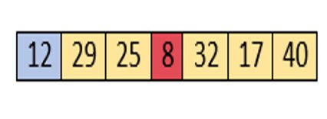

At present, 12 is stored at the first position, after searching the entire array, it is found that 8 is the smallest value.
So, swap 12 with 8. After the first iteration, 8 will appear at the first position in the sorted array.

Slide 11

For the second position, where 29 is stored presently, we again sequentially scan the rest of the items of unsorted array.
After scanning, we find that 12 is the second lowest element in the array that should be appeared at second position.

Slide 12

Swap 29 with 12.
After the second iteration, 12 will appear at the second position in the sorted array.
So, after two iterations, the two smallest values are placed at the beginning in a sorted way.

Slide 13
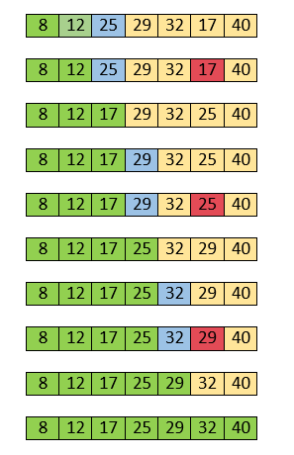
The same process is applied to the rest of the array elements.
Now the array is completely sorted.

Slide 14
ADVANTAGES
It performs well on a small list.
Order of elements with equal values is preserved during the sort.
Relatively efficient and easy to implement.

Slide 15
DISADVANTAGES
Doesn't work well on large sets.
Has poor cache performance.
Needs to iterate over the list multiple times; thus, it can lead to an unbalanced branch.

Slide 16
2. INSERTION SORT

Slide 17
INSERTION SORT
Insertion sort algorithm is a basic sorting algorithm that sequentially sorts each item in the final sorted array or list.
Time Complexity :O(n²)
Space Complexity :O(1)

Slide 18
ADVANTAGES
Insertion sort has various advantages such as :
Simple implementation.
Efficient for small data sets.
It is appropriate for data sets that are already substantially sorted.

Slide 19
ALGORITHM
Step 1: If the element is the first element, assume that it is already sorted.
Return 1.
Step 2: Pick the next element and store it separately in a key.
Step 3: Now, compare the key with all elements in the sorted array.

Slide 20
ALGORITHM
Step 4: If the element in the sorted array is smaller than the
current element, then move to the next element.
Else, shift greater elements in the array towards the right.
Step 5: Insert the value.
Step 6: Repeat until the array is sorted.

Slide 21
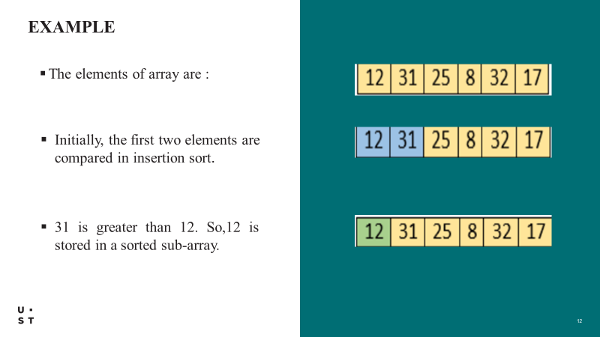

Slide 22
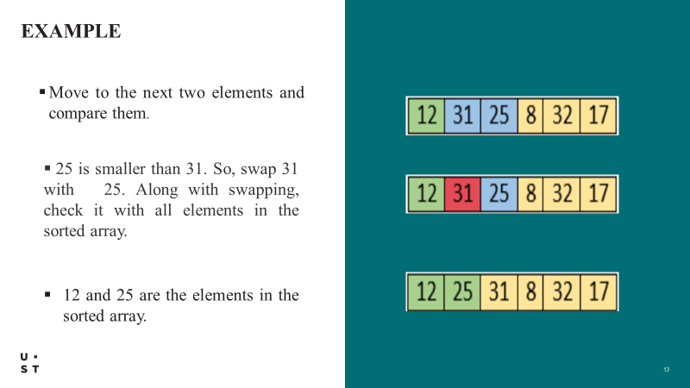

Slide 23
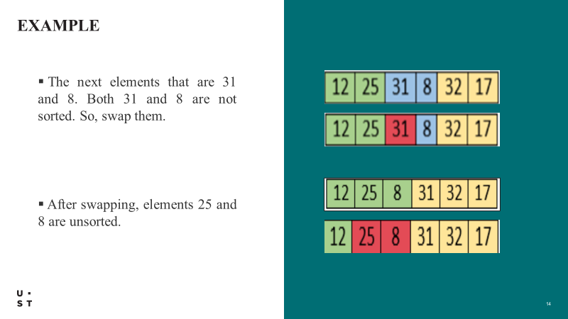

Slide 24
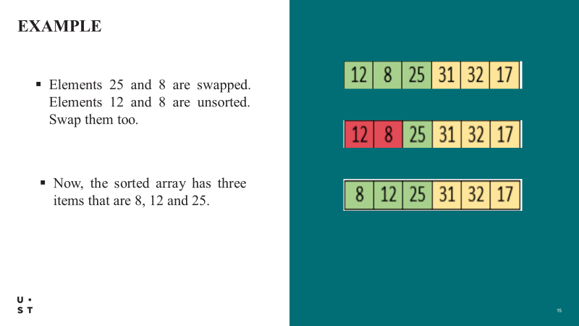

Slide 25
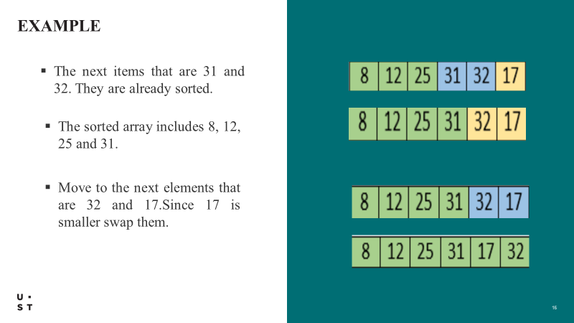

Slide 26
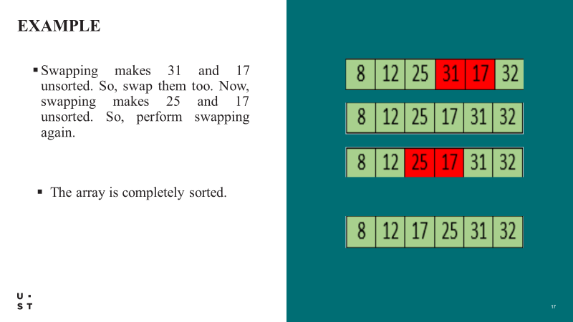

Slide 27
DISADVANTAGES
Inefficient for large lists (time complexity increases exponentially with the size of the list).
Not suitable for lists with many duplicate elements.
Not adaptable to different data structures.

Slide 28
.BUBBLE SORT
3

Slide 29
BUBBLE SORT
Simplest sorting algorithm that works by repeatedly swapping the adjacent elements.
This algorithm is not suitable for large data sets.
average and worst-case time complexity is quite high.
The average and worst-case complexity of Bubble sort is O(n2), where n is a number of items.
Time complexity of best case is O(n)

Slide 30
Working process
Starting from the first index, compare the first and the second elements.
If the first element is greater than the second element, they are swapped.
Now, compare the second and the third elements. Swap them if they are not in order.
The above process goes on until the last element.
The same process goes on for the remaining iterations.
After each iteration, the largest element among the unsorted elements is placed at the end.

Slide 31



Let the elements of array are -
First Pass:
Sorting will start from the initial two elements.
Here,13<32, so it is already sorted. Now, compare 32 with 26.

Slide 32



Here, 32 is grater than 26. So, swapping is required.
Now, compare 32 and 35.
32 is less than 35. So, there is no swapping required
Now, the comparison will be in between 35 and 10.
35>10 So, swapping is required.
After first pass, the array will be -

Slide 33
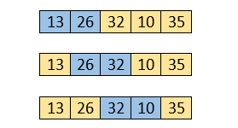
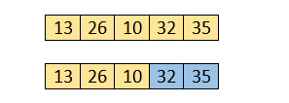
Second Pass:
The same process will be followed for second iteration.
Here 32>10,So swapping is required

Slide 34
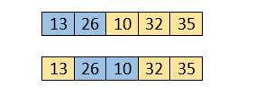
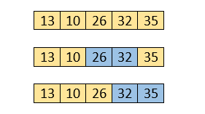
Third Pass
The same process will be followed for third iteration
Here, 26>10. So, swapping is required.
After swapping, the array will be -

Slide 35

Fourth pass
Similarly, after the fourth iteration, the array will be -
Hence, there is no swapping required, so the array is completely sorted.

Slide 36
Algorithm
Begin BubbleSort( list)
For all elements of list
if list[i]>list[i+1]
swap(list[i], list[i+1]) end if end for return list end BubbleSort

Slide 37
Advantages:
Bubble sort is easy to understand and implement.
It does not require any additional memory space.
It’s adaptability to different types of data.

Slide 38
Disadvantages
Time complexity of O(n^2) which makes it very slow for large data sets.
It is not a stable sorting algorithm, elements with the same key value may not maintain their relative order

Slide 39
MERGE SORT
04.

Slide 40
MERGE SORT
Merge sort is a sorting algorithm that works by dividing an array into
smaller subarrays, sorting each subarray, and then merging the sorted
subarrays back together to form the final sorted array.
Time Complexity: O(N logN)
Space Complexity: O(N)

Slide 41
Working Process
Continuously splits the array in half until it cannot be further divided. This means that if the array becomes empty or has only one element left, the dividing will stop.
If the array has multiple elements, split the array into halves and recursively invoke the merge sort on each of the halves.
Finally, when both halves are sorted, the merge operation is applied. Merge operation is the process of taking two smaller sorted arrays and combining them to eventually make a larger one.

Slide 42
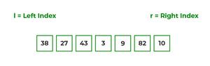
Working Process
To know the functioning of merge sort, let's consider an array
arr[] = {38, 27, 43, 3, 9, 82, 10}
check if the left index of array is less than the right index, if yes then calculate its mid point

Slide 43
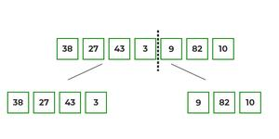
Working Process
Array of 7 items is divided into two arrays of size 4 and 3 respectively.
If left index is less than the right index for both arrays, then again calculate mid points for both the arrays.

Slide 44
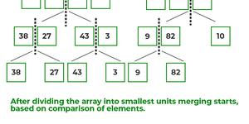
Working Process
further divide these two arrays into further halves, until further division is not possible.

Slide 45
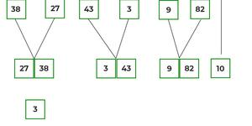
Working Process​
​
​
After dividing the array into smallest units, start merging the elements again based on comparison of size of elements

Slide 46
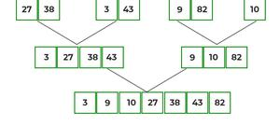
Working Process
After the final merging

Slide 47
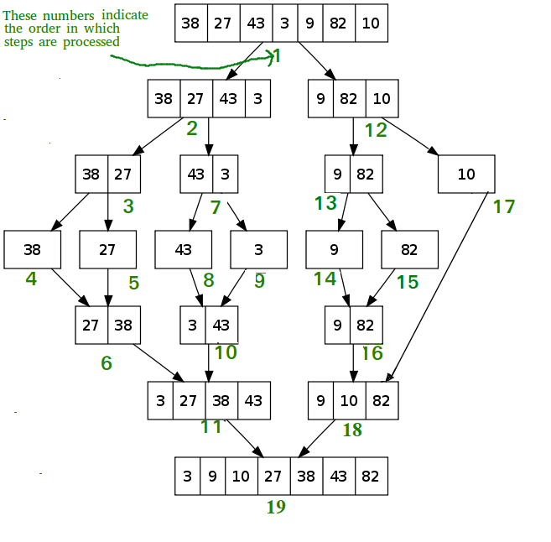

Slide 48
Algorithm
step 1: start
step 2: declare array and left, right, mid variable
step 3: perform merge function. if left < right mid= (left+right)/2 mergesort(array, left, mid) mergesort(array, mid+1, right) merge(array, left, mid, right)
step 4: Stop

Slide 49
ADVANTAGES
Sort large arrays relatively quickly.
Order of elements with equal values is preserved during the sort.
Relatively efficient and easy to implement.

Slide 50
DISADVANTAGES
Requires an additional memory space to store the subarrays that are used
Requires more code to implement
Slower compared to the other sort algorithms for smaller tasks.

Slide 51
QUICK SORT
05.

Slide 52
QUICK SORT
Quicksort picks an element as pivot, and then it partitions the given array around the picked pivot element.
In quick sort, a large array is divided into two arrays in which one holds values that are smaller than the specified value (Pivot), and another array holds the values that are greater than the pivot.
After that, left and right sub-arrays are also partitioned using the same approach. It will continue until the single element remains in the sub-array.
Time Complexity: O(N logN)
Worst Case Complexity:O(n²)
Space complexity of quicksort is O(n*logn)

Slide 53
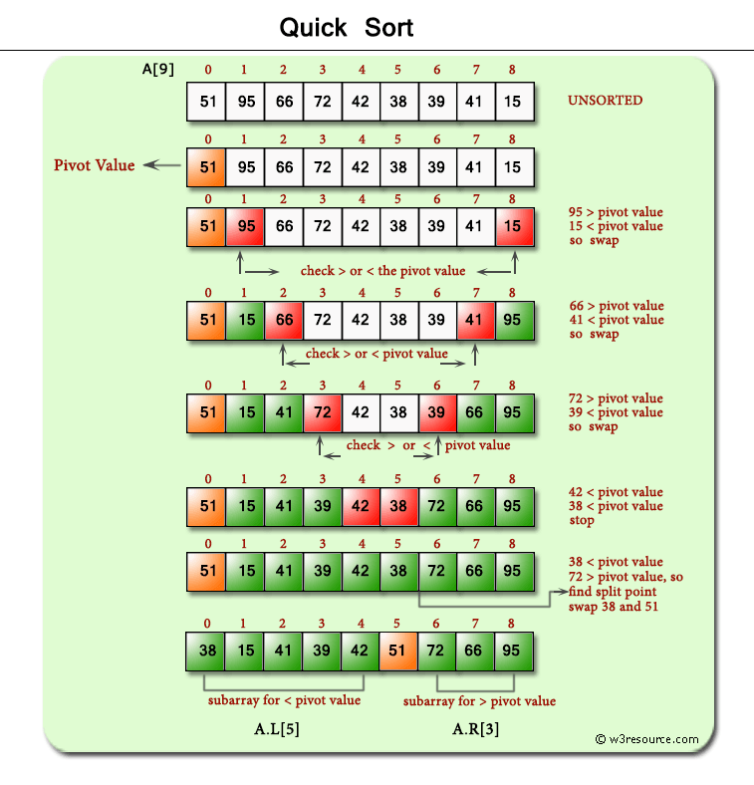

Slide 54
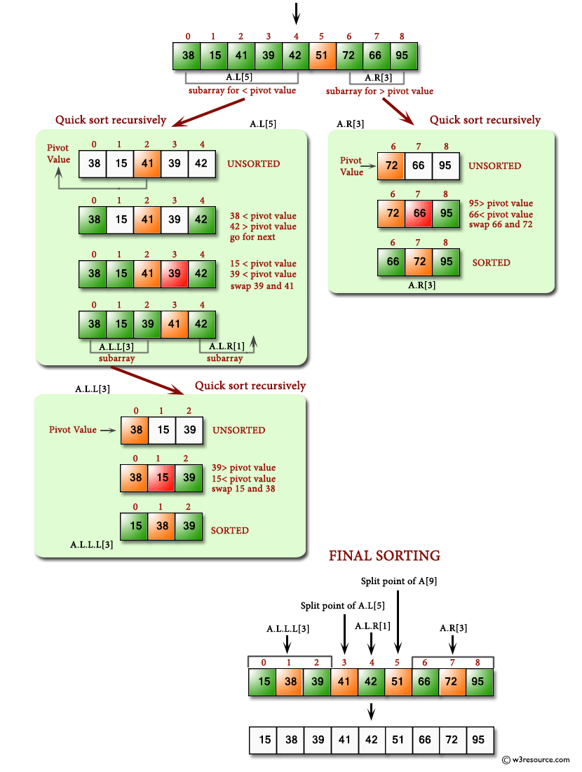

Slide 55
The Quicksort is the fastest known sort algorithm because of its highly optimized partitioning of an array of data into smaller arrays.
CONCLUSION

